Slide 1
Appointment Window Updates
AI Agent assisted workflow

Slide 2
Appointment Windows
The p44 Decision Intelligence Platform relies on accurate appointment windows to ensure data completeness and accuracy, and in turn the generation of accurate and precise ETAs.
However
Appointment windows are often outdated, or misaligned with operational realities and result in:
  The creation of false exceptions and missed pickup/delivery risk
  Degradation of Visibility KPIs due to reduced data availability & accuracy, reduced milestone availability & accuracy, and reduced visibility in general
  Inaccurate ETAs
  Manual processing outside of Movement, negating the value of Movement as a source of truth.
As a result, the systemic representation of the shipment often diverges from what is actually happening operationally.
Enabling carriers to update appointment windows closes the loop between operational reality and system representation, reducing false exceptions while measurably improving data quality and reliability.

Slide 3
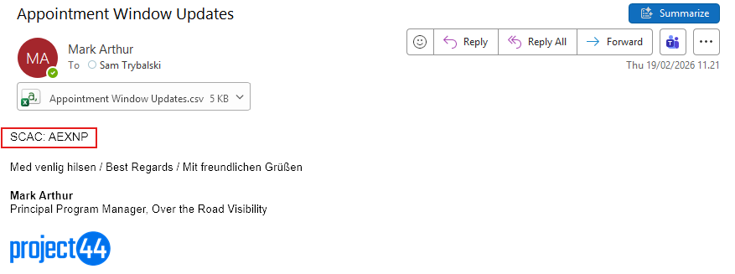
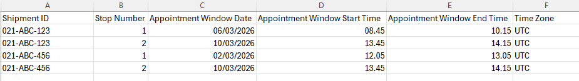
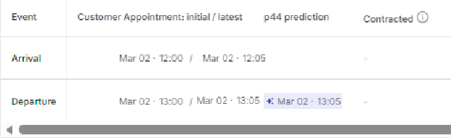
Ai Agent Assisted Appointment Window Updates
Send an email to sam.trybalski@project44.com, with Appointment Window Updates in the subject line, who will triage the incoming request.
The email must contain a completed CSV (enclosed) and a carrier ID in the body of the email.
Carrier IDs can be one of SCAC, DOT, MC, VAT or p44_EU
01
Provided all data is present and correct, Sam will push the updates to the p44 APIs, updating the shipments contained in the CSV file.
If Sam finds issues with the CSV or Carrier ID, he will respond to the user requesting the sender takes the necessary steps to resolve.
.
02
03
Appointment Windows are updates on the shipment

Slide 4
FAQs
Q. How do I know appointment windows have been updated?
A. If the CSV contains all required data and the Carrier ID is included in the email body, the file will be processed and confirmed to the user by Sam.
The updated appointment window will be reflected on the shipment record in Movement.
Sam does not have access to API responses, so is unable to confirm that all API criteria have been met, for example if the shipment ID does not exist in Movement.
Q. How many shipments can I update at once?
A. There is a limit of approx. 400 rows per email.
Q. What is a P44_EU ID?
A. The P44_EU is the unique shipment identifier generated by project44 upon signup and is available under my company
Q. What time-zone should I use?
A. Use the local time-zone of the appointment location (Origin or Destination).
Ensure the time-zone aligns with the physical stop location to prevent incorrect ETA calculations. You can use IANA or ISO formats. City names are also accepted.
Q. Can I just update the Origin or Destination, or do I have to update all stops every time?
A. You only need to update the specific stop that changed.
There is no requirement to resubmit all stops unless multiple appointment windows need revision.
Q. Where can I find the CSV template?
A. The standardized CSV template is available through your project44 contact or shared documentation portal.
Always use the latest template version to avoid formatting errors.
Q. Can I update appointment windows in the past?
A. No you are unable to update appointment windows that are in the past.
Q. Can Sam handle other requests or queries?
A. Sam is designed to support structured workflow requests such as appointment window updates.
For unrelated operational issues, milestone sourcing, or exception handling, additional AI Agent workflows may apply and Sam will point you in the right direction

